Slide 1
Synthetic Control Methods for Comparative
Case Studies: Estimating the Effect of California’s
Tobacco Control Program
By Abadie, Diamond, Hainmueller
Discussion by Jeff Denning

Slide 2
What is the question?
What is the effect of California’s Proposition 99 (anti smoking initiative) on smoking (cigarette sales)?
Why is this tricky?
Basically this only occurred for one state

Slide 3
What could we do (using tools from earlier)?
One thing would be to pick a nearby state and run a 2x2 (or perhaps 2xT) difference in differences. (What other paper we read does this?)
Another would be to compare California to all other states.
This is feasible but we would be putting weight on states that may be very different from California.

Slide 4
What does Synthetic Control Do?
It constructs a “synthetic” California that is a weighted average of other states.
The researcher specifies the donor pool (other states) and predictor variables.
Next, a procedure determines which combinations of states provides the best approximation of California
You can then check to see if synthetic California looks similar in levels and trends to actual California.
It may be that it is impossible to find a good synthetic control (convex hull)
WSJ

Slide 5
Data
Per Capita sales of cigarettes
Exclude four states that introduced statewide tobacco control programs and states that raised cigarette taxes.
Retail price of cigarettes, per capita state income, percent of population 15-24 years old, per capita beer consumption

Slide 6
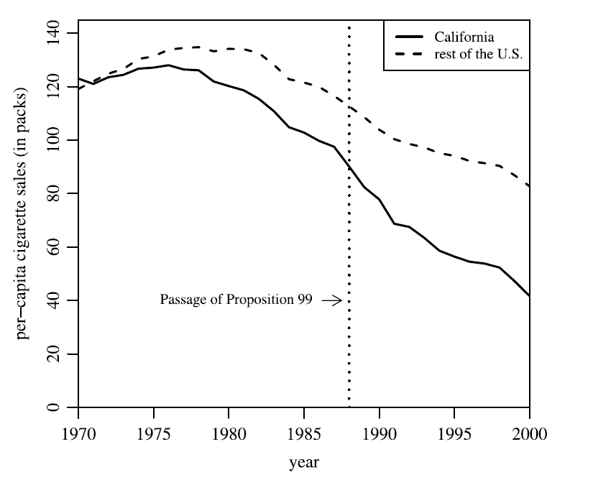
California versus Everybody

Slide 7
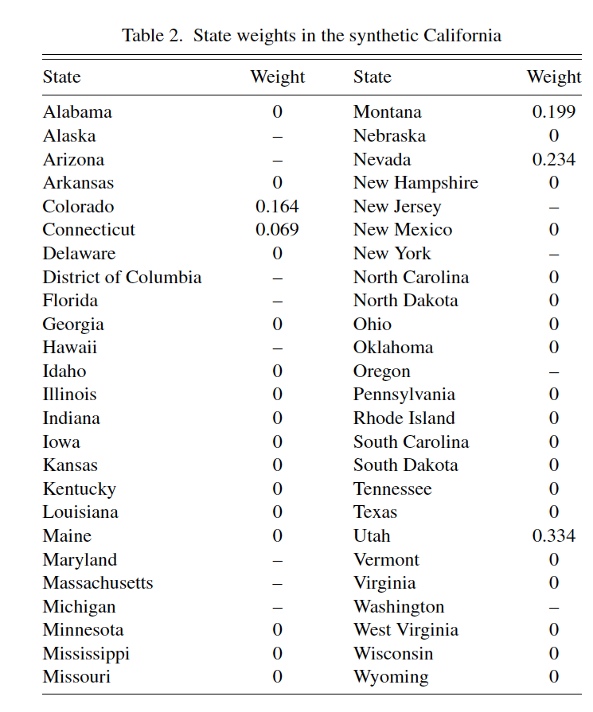
Which States are Synthetic California?

Slide 8
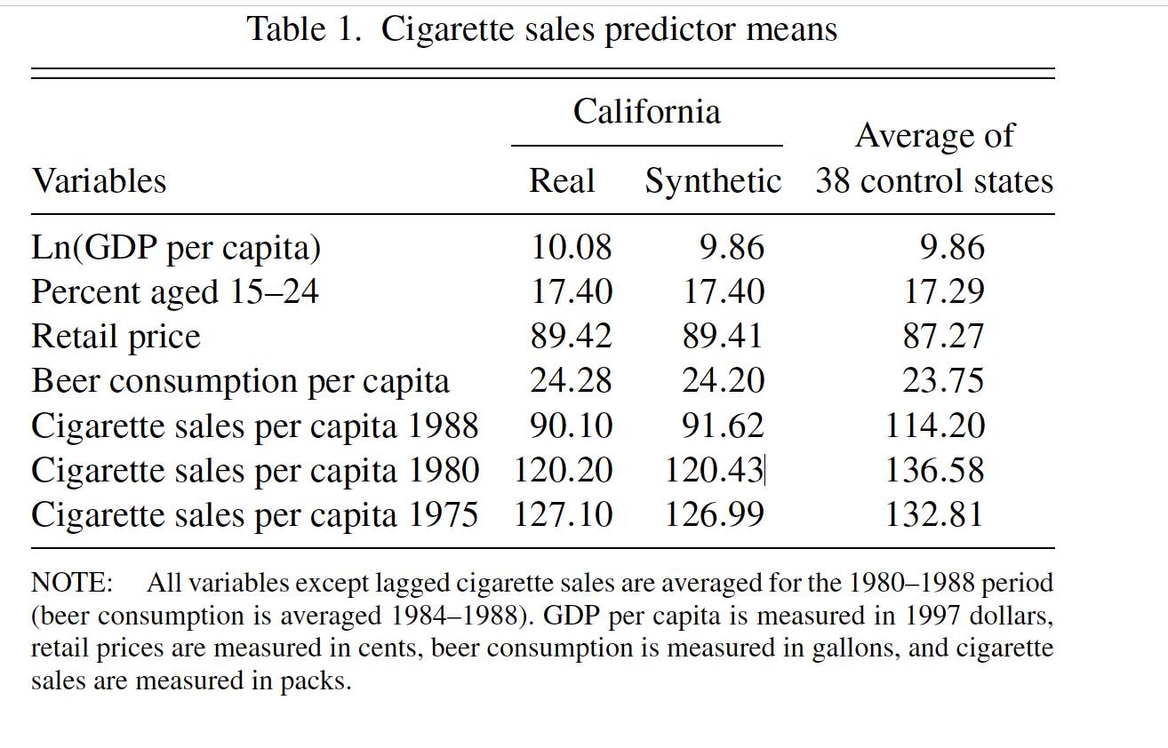
California, Real and Synthetic

Slide 9
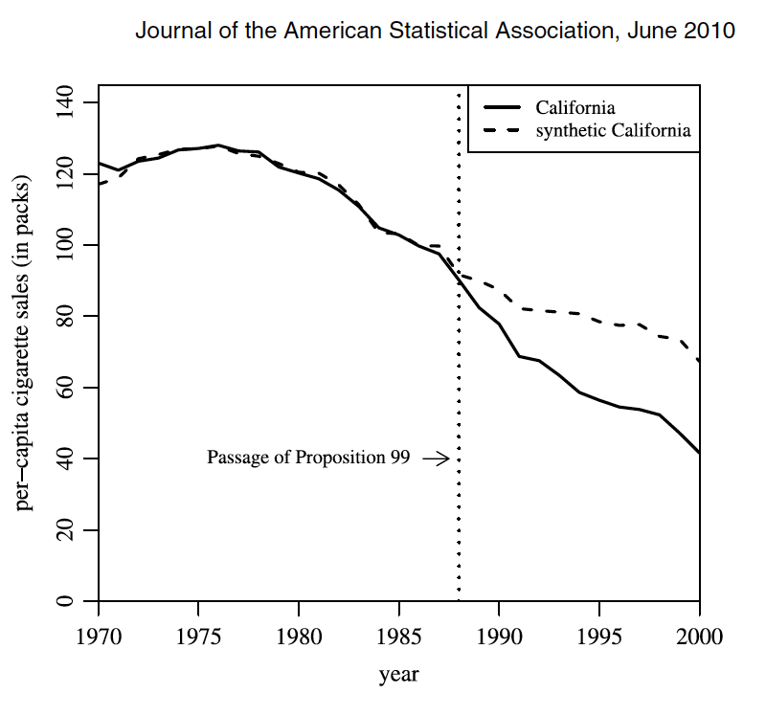
California Versus Synthetic California

Slide 10
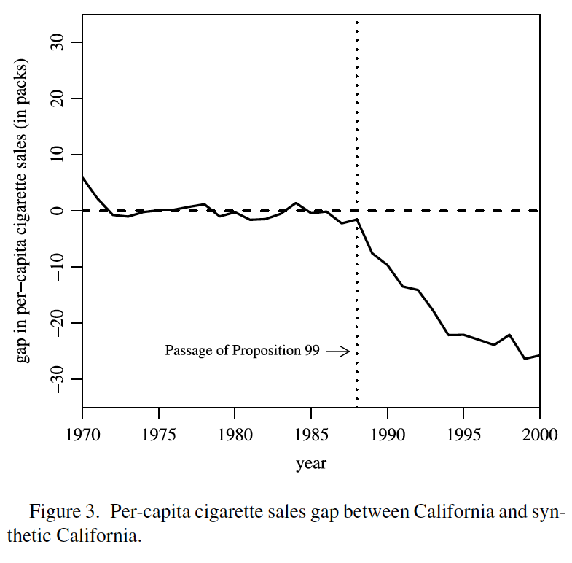
Another Way to Show the Same Thing

Slide 11
Inference
It is not immediately obvious how to do inference with the Synthetic Control.
The typical way is to do a bunch of “placebo” exercises where you do a synthetic control for all other states using the same predictor variables.
Next, you plot the figures to see how extreme the situation you study is
This uses post/pre MSPE

Slide 12
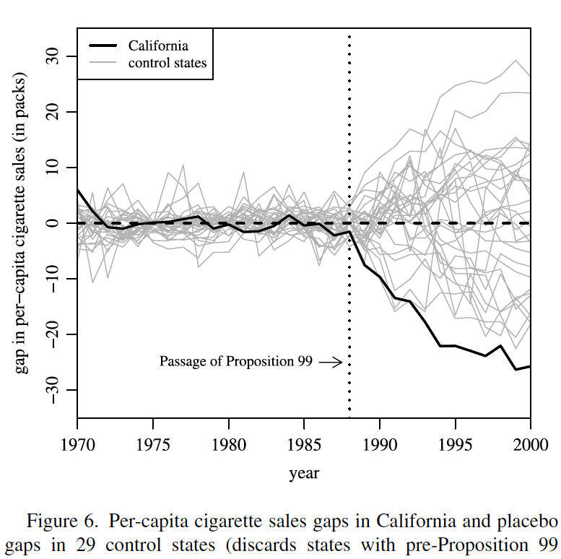
Permutation Test

Slide 13
Results
Proposition 99 reduced cigarette sales in California
Synthetic Control provides a nice way to look at comparative case studies.
Transparent about the counterfactual
Reduces the ability for researchers to choose the control group

Slide 14
An introduction
https://www.washingtonpost.com/news/wonk/wp/2015/10/30/how-to-measure-things-in-a-world-of-competing-claims/

